Slide 1

Watchdog
Automated System Design
Last Updated: September, 2009

Slide 2
Watchdog

Slide 3
Interactive Features – Normal Mode
Play .WAV file via house audio system on the following events:
External Door Open Door_Opened.wav
External Door Close Door_Closed.wav
External Door Unlocked Door_Unlocked.wav
External Door Locked Door_Locked.wav
Garage Door Opened GDoor_Up.wav
Garage Door Closed GDoor_Down.wav
Upstairs Hallway Motion Detected* Motion_Detected.wav
Speak via Windows TTS Synthesizer (MS Mary voice) on the following events:
Mail Delivered “You’ve Got Mail”
Status Check (3 times between 9:30pm “Attention, the following security items must be addressed”
  – 10:00pm) if status is not secure Garage door, Front door lock, Back door lock, Outside door
  lock, Basement door lock
External door left opened for 1 minute** “Attention, Please close the ??? door”
Greeting upon return to house and open “Welcome Back. While you were gone you missed X Phone
of an external door calls, Y Visitors, and the mail being delivered”.
Temperature Alert (<65 or >85) “Is it just me, or is it hot/cold in here?”
If Garage Door is open and Garage Temp <45 “Attention, Please close the garage door” every 10 min.
Other
On departure, if the house is empty, check the status of the external door locks. Send SMS Text message to the last person to leave if any doors are unlocked.
5 minutes after the last car departs and the house is empty, turn off lights
On arrival of a car, if the house was empty and the time is after 7PM, turn on the lights
* Sound only played between the hours of 9PM and 7AM
** Mudroom door waits 3 minutes to allow loading/unloading of the cars

Slide 4
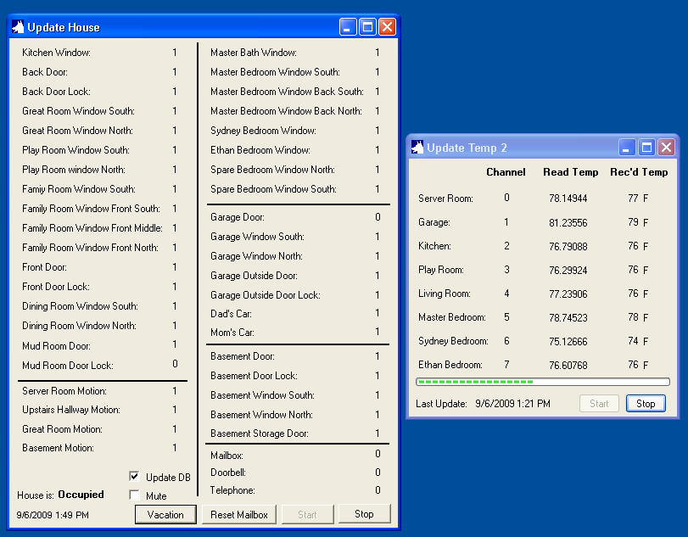
Normal Mode GUI

Slide 5
Interactive Features – Vacation Mode
When initiating Vacation Mode
Initiates a 5 minute delay before starting
With 1 minute remaining, it speaks a warning that Vacation Mode is about to start
Sends an SMS text message warning about doors being unlocked
When Vacation Mode is started, it sends a SMS text message to both phones indicating successful start.
When Vacation Mode is Active
Aggressively monitors motion and external doors
If external door open is detected, it sends an SMS Text message to both phones
If motion is detected:
  It sends an SMS Text message to both phones and
  Plays a loud warning horn and speaks a warning that the owners have been notified
  Sleeps for 1 hour, to avoid sending updates too frequently
Provides an alternate GUI that:
  Shows the 50 most recent events
  Tracks the missed phone calls
  Tracks the missed visitors
Automatically turns on/off lights in the house at random times via X10 to make it appear that the house is occupied.

Slide 6
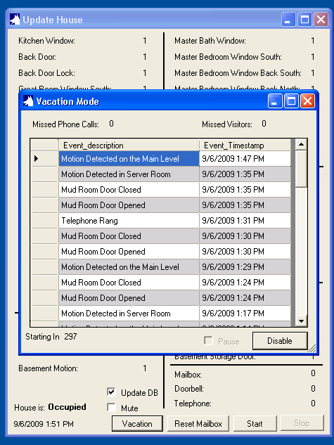
Vacation Mode GUI

Slide 7
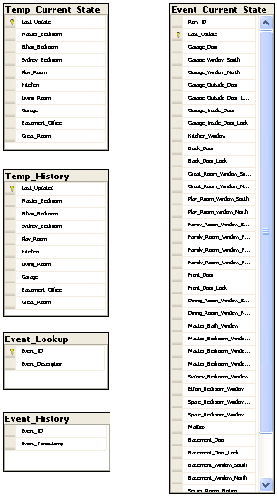
Data Model
Tables:
Temp_Current_State: Holds the most recently read temp values (1 rows)
Temp_History: Holds the last 24 hours of temp values
Event_Current_State: Holds the most recently read house status values (2 rows)
Event_History: Holds 1 month of Event History
Event_Lookup: Static lookup of Event ID values to text
Triggers:
Temp_Current_State_Archive: On Update, Takes the most recently read temp values in Temp_Current_State and inserts them in Temp_History. Also, deletes rows in Temp_History older than 24 hours.
Event_Current_State_Archive: On Update, Takes the changed data from Event_Current_State and inserts a row into Event_History.
Event_History_Purge: On Insert, deletes all the rows older than 1 month.
Temp_Alert: On update, checks for high/low temperature values

Slide 8
Reports
SQL Server 2008 Reporting Services
Current Status Report
  Shows the current state of each sensor in the house
  Pulls from Event_Current_State
  Links to Event History Report
Event History Report
  Shows the list of the last 200 events (approx 2 – 3 days)
  Pulls from Event_History
  Links to Current Status Report
Current Temp Report
  Shows the current temp of each sensor in the house
  Pulls from Temp_Current_State
  Links to:
    Garage Temp History Report – Graph
    Kitchen Temp History Report – Graph
    Playroom Temp History Report – Graph
    Living Room Temp History Report – Graph
    Master Bedroom Temp History Report – Graph
    Sydney’s Bedroom Temp History Report – Graph
    Ethan’s Bedroom Temp History Report - Graph

Slide 9
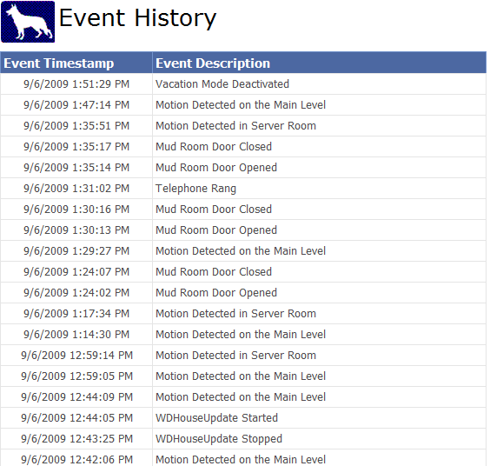
Reports – Event History

Slide 10
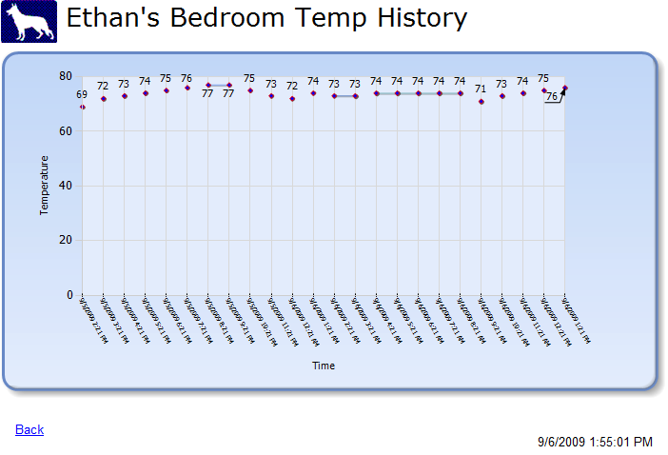
Reports – Temperature Graph Sample

Slide 11

Module Overview
S.A.R.A.H
10011010
01111000
WDX10
WDHouseUpdate
SQL Server 2008
Reporting
Services
WDSendTextMsg
WDPlay_Voice
Watchdog
WDTempUpdate
WDPlay_Sound
SQL Server 2008
Express Ed.
10011010
01111000
Reporting Service Sites:
User: http://192.168.1.202/ReportServer_WATCHDOG/
Admin: http://192.168.1.202:8080/Reports_WATCHDOG/Pages/Folder.aspx

Slide 12
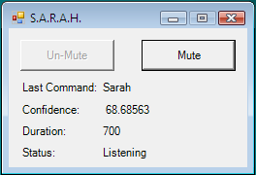
S.A.R.A.H
Self Actuated Residential Automated Habitat
Voice recognition and response system
Queries the Watchdog database and RSS XML data feeds from the Internet to answer questions about house status, house temperature and weather.
Some commands:
House Status
<name a room in the house>
Upstairs Temperature
House Temperature
What should I wear today?
Should I turn the water off?
Forecast
What’s the weather like?
Wake up Mom/Dad
What can I say?
Who are you?

Slide 13
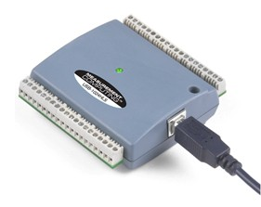
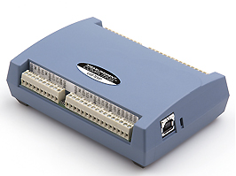
Data Input Devices
Digital IO x 2
Measurement Computing USB-1024HLS
USB bus-powered digital I/O module with 24 high-current (64 mA sink, 15 mA source) digital I/O lines
Digital Temperature:
Measurement Computing USB-TEMP
USB-based 8-channel temperature measurement module supports 4 sensor types
Cantherm Thermistor 10KΏ

Slide 14
Temp Sensor Connections
Board #1:
Measurement Computing USB-TEMP
 | Sensor
0 | Server Room
1 | Garage
2 | Kitchen
3 | Play Room
4 | Living Room
5 | Master Bedroom
6 | Sydney’s Bedroom
7 | Ethan’s Bedroom

Slide 15
DIO Sensor Connections
Board #2:
Measurement Computing USB-1024HLS
A | Sensor | B | Sensor | C | Sensor
0 | Kitchen Window | 0 | Living Room Front S | L0 | Mudroom Door Lock
1 | Back Door | 1 | Living Room Front C | L1 | Garage Window N
2 | Back Door Lock | 2 | Living Room Front N | L2 | Garage Window S
3 | Great Room Window N | 3 | Front Door | L3 | Garage Door
4 | Great Room Window S | 4 | Front Door Lock | H0 | Garage Outside Door
5 | Play Room Window N | 5 | Dining Room Window S | H1 | Garage Outside Door Lock
6 | Play Room Window S | 6 | Dining Room Window N | H2 | Mailbox
7 | Living Room Window S | 7 | Mudroom Door | H3
Board #3:
Measurement Computing USB-1024HLS
A | Sensor | B | Sensor | C | Sensor
0 | Master Bath Window | 0 | Basement Door | L0 | Telephone
1 | MBR Window S | 1 | Basement Door Lock | L1 | Car West
2 | MBR Window Back S | 2 | Basement Window S | L2 | Car East
3 | MBR Window Back N | 3 | Basement Window N | L3 | Basement Storage Door
4 | Sydney BR Window | 4 | Upstairs Hall Motion | H0 | Basement Motion
5 | Ethan BR Window | 5 | Server Room Motion | H1 | Exterior Motion
6 | Spare BR Window N | 6 | Great Room Motion | H2
7 | Spare BR Window S | 7 | Doorbell | H3

Slide 16
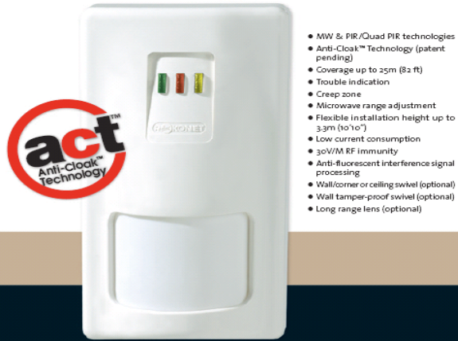
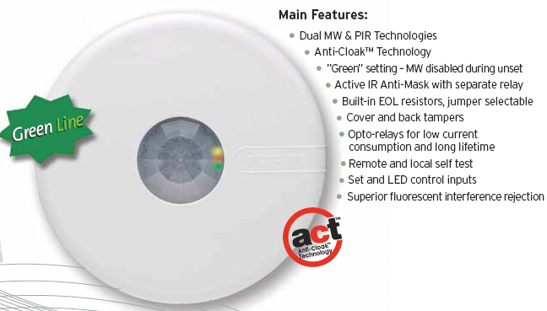
Motion Sensors
Server Room & Basement Motion Sensor:
Roconet iWise DT
Mid-range (50’) model
Dual technology (Microwave, Infrared), Dual element
Great Room Motion Sensor:
Roconet iWise DT-Quad
Mid-range (50’) model
Dual technology (Microwave, Infrared), Dual element
Anti-Cloak Technology
Upstairs Hallway Motion Sensor:
Roconet LuNAR DT - Ceiling Mount
Dual technology (Microwave, Infrared)
360° coverage
Anti-Cloak Technology

Slide 17
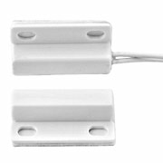
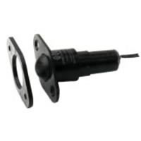
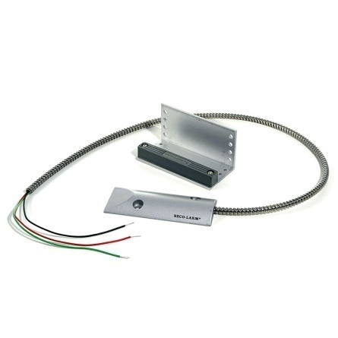
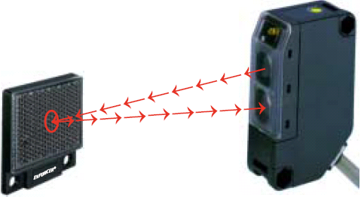
Other Sensors
Window Sensors:
Honeywell MPS-45WG
Sub-mini surface mount magnetic contact with exit leads
Door Sensor:
Roller Ball / Plunger Contact switch
Garage Door Sensor:
Seco-Larm ODC-59A
Magnetic
Car Park Sensor:
Seco-Larm Enforcer E-931-S35RR
Retroreflective Photoelectric Sensor

Slide 18
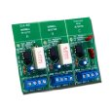
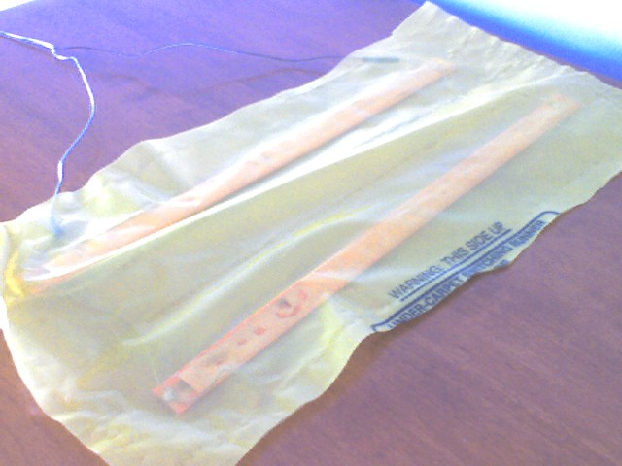
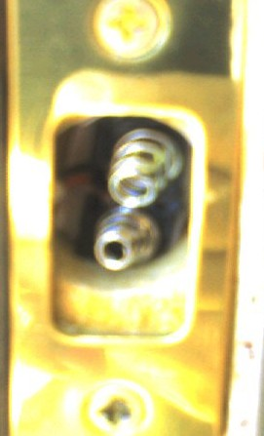
Other Sensors
Mailbox Sensor:
Honeywell MPS-45WG
Sub-mini surface mount magnetic contact with exit leads
Doorbell & Telephone Sensor
ELK Doorbell & Telephone Ring Detector ELK-930
2 Telephone 1ines, 1 doorbell; Relay switch
Stair Sensor:
Weight sensor bars
Door Lock Sensor:
Custom deadbolt contact sensor with metal springs

Slide 19
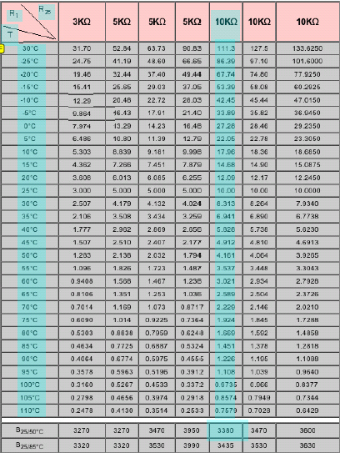

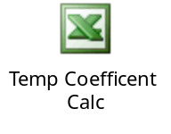
Temp Sensors
Cantherm Thermistor 10KΏ
Steinhart-hart equation for determining co-efficients:
Calculation:
A = 0.000545
B = 0.000305
C = 0

Slide 20
Event Codes
2001 | Garage Door Open
2002 | Garage Door Closed
2003 | Garage Window South Open
2004 | Garage Window South Closed
2005 | Garage Window North Open
2006 | Garage Window North Closed
2007 | Garage Outside Door Open
2008 | Garage Outside Door Closed
2009 | Garage Outside Locked
2010 | Garage Outside Unlocked
2011 | Garage Inside Door Open
2012 | Garage Inside Door Closed
2013 | Garage Inside Unlocked
2014 | Garage Inside Locked
2015 | Kitchen Window Open
2016 | Kitchen Window Closed
2017 | Back Door Open
2018 | Back Door Closed
2019 | Back Door Unlocked
2020 | Back Door Locked
2021 | Great Room Window North Open
2022 | Great Room Window North Closed
2023 | Great Room Window South Open
2024 | Great Room Window South Closed
2025 | Play Room Window North Open
2026 | Play Room Window North Closed
2027 | Play Room Window South Open
2028 | Play Room Window South Closed
2029 | Family Room Window South Open
2030 | Family Room Window South Closed
2031 | Family Room Window Front South Open
2032 | Family Room Window Front South Closed
2033 | Family Room Window Front Middle Open
2034 | Family Room Window Front Middle Closed
2035 | Family Room Window Front North Open
2036 | Family Room Window Front North Closed
2037 | Front Door Open
2038 | Front Door Closed
2039 | Front Door Unlocked
2040 | Front Door Locked
2041 | Dining Room Window South Open
2042 | Dining Room Window South Closed
2043 | Dining Room Window North Open
2044 | Dining Room Window North Closed

Slide 21
Event Codes
1001 | Basement Door Open
1002 | Basement Door Closed
1003 | Basement Door Unlocked
1004 | Basement Door Locked
1005 | Basement South Window Opened
1006 | Basement South Window Closed
1007 | Basement North Window Opened
1008 | Basement North Window Closed
1009 | Basement Storage Door Opened
1010 | Basement Storage Door Closed
5000 | Mail State Reset
5001 | Mail Delivered
5002 | Mail Retrieved
5003 | Doorbell Rang
5004 | Telephone Rang
5005 | Moms Car Arrived
5006 | Moms Car Departed
5007 | Dads Car Arrived
5008 | Dads Car Departed
5009 | Security Warning Text Message Sent
5010 | Lights Turned On
5011 | Lights Turned Off
5012 | Vacation Mode Activated
5013 | Vacation Mode Deactivated
5014 | Intruder Detected
5015 | Welcome Home Greeting
5016 | Door Open Warning
5017 | Door Lock Warning
5018 | Upstairs Too Hot
5019 | Upstairs Too Cold
5020 | Main Level Too Hot
5021 | Main Level Too Cold
5022 | Server Room Too Hot
5023 | House is now Occupied
5024 | House is now Unoccupied
3001 | Master Bath Window Open
3002 | Master Bath Window Closed
3003 | Master Bedroom Window Back South Open
3004 | Master Bedroom Window Back South Closed
3005 | Master Bedroom Window Back North Open
3006 | Master Bedroom Window Back North Closed
3007 | Master Bedroom Window South Open
3008 | Master Bedroom Window South Closed
3009 | Guest Bedroom Window 1 Open
3010 | Guest Bedroom Window 1 Closed
3011 | Guest Bedroom Window 2 Open
3012 | Guest Bedroom Window 2 Closed
3013 | Ethan Bedroom Window Open
3014 | Ethan Bedroom Window Closed
3015 | Sydney Bedroom Window Open
3016 | Sydney Bedroom Window Closed

Slide 22
Event Codes
6001 | Motion Detected in Server Room
6002 | Motion Detected in Upstairs Hallway
6003 | Motion Detected on the Main Level
6004 | Motion Detected in Basement
6005 | Motion Detected on Exterior Cameras
9001 | WDHouseUpdate Started
9002 | WDHouseUpdate Stopped
9003 | WDTempUpdate Started
9004 | WDTempUpdate Started
9005 | SARAH Started
9006 | SARAH Stopped
9007 | SARAH is Listening
9008 | SARAH is Sleeping
9999 | Error

